Slide 1
Swarm Operations and Autonomous Rescue
S.O.A.R.
Critical Design Review
Presented by Group 22
Sponsored by Lockheed Martin
Notes:
Team Member Introductions…

Slide 2



The ECE Team
Kate Archibald
Electrical Engineering
Ethan Fluhr
Computer Engineering
Abdul Memon
Computer Engineering

Slide 3



The MAE Team
Nawaf Aljudaybi
Aerospace Engineering
Badr Binafif
Aerospace Engineering
Collin Sumner
Mechanical Engineering

Slide 4
Motivation and Background
In response to natural disaster, search and rescue teams play a critical role in saving lives. Their mission is to locate and assist survivors. As technology evolves, so do our methods. Drones are being introduced to enhance search and rescue operations.
  Drones offer some unique benefits human typically don’t have with their aerial perspective, thermal imaging capabilities, and rapid deployment.
  A drone swarm also reduces risk for rescuers when sending them into hazardous conditions such as the aftermath of a natural disaster.
SOAR aims to develop a heterogeneous drone swarm designed to improve search and rescue efficiency. Each drone, equipped with a specialized set of technologies, will maximize real-time data transmission to a base station, ultimately increasing the rate of successful rescues.

Slide 5
Goals and Objectives
Goal: Develop an autonomous heterogeneous drone swarm for search and rescue applications.
Overall Objectives:
Allow command inputs from the base station to direct actions on the drone.
Establish a wireless mesh network communication between drones and the base station.
Must autonomously maneuver itself.
Integrate real-time obstacle avoidance.
Detect targets for rescue autonomously.
Provide GPS location of itself upon detecting a target.

Slide 6
Goals and Objectives Continued
Electrical Objectives:
Implement MAVLink for drone and base station communication
Implement a variety of sensors including altitude, acceleration, orientation as well as GPS, LiDAR, and radar for autonomous flight.
Implement AI processor and EO/IR video cameras for autonomous target detection.
Mechanical Objectives:
Design drones to be lightweight and aeroefficient.
Optimize propulsion system to minimize energy consumption.
Stretch Goals:
Achieve centimeter precision using RTK on the GPS
Optimize drone design for efficient recharging

Slide 7
Engineering Specifications
EO & IR Camera
Thermal Camera Size | 25.7mm x 17.7mm x 16.0mm
Thermal Camera Weight | 3.5g
Range of Thermal Detection | -40°C < x < 300°C
Cost of Thermal Camera | $40 < x < $60
Accuracy Percentage Within Distance | ±2°C
Communication Spec
GPS Update Rate | 10 Hz < x < 20 Hz
Video Transfer Frequency | 5.8 GHz
Communication Range | 1 km < x
Thermal Camera Resolution | 320x256
Obstacle Detection
Horizontal FOV | 360°
Range of Effective Distance | 12m < x < 25m
Accuracy Percentage Within Distance | 90%
Size of Sensor | 55.6x55.6.41.3mm
Normal Camera Resolution | 2688x1520
Normal Camera FOV | 104°x 57°
Normal Camera FPS | 20 FPS
Normal Camera Size | 109.9mm x 81mm
Normal Camera Weight | 470g
Thermal Camera FPS | 32 FPS

Slide 8
Engineering Specifications Continued
Battery
Maximum Current Draw | 54 to 77 amps
Minimum Voltage Input | Approximately 22V
Flight Time | Approximately 13 min
Performance
Frame size | 700mm
Max takeoff weight | 3268g
Hover time | 23.1 (min)
Specific Thrust | 7.47 g/W
Max speed | 56 km/h
Range | 5280m
Motors
Motor Speed | Approximately 400 KV
Motor Current | Approximately 45A
Thrust | Approximately 2.5kg
Motor Size | 47.5mm (d) x 37.5mm (l)
Motor Weight | 165g

Slide 9
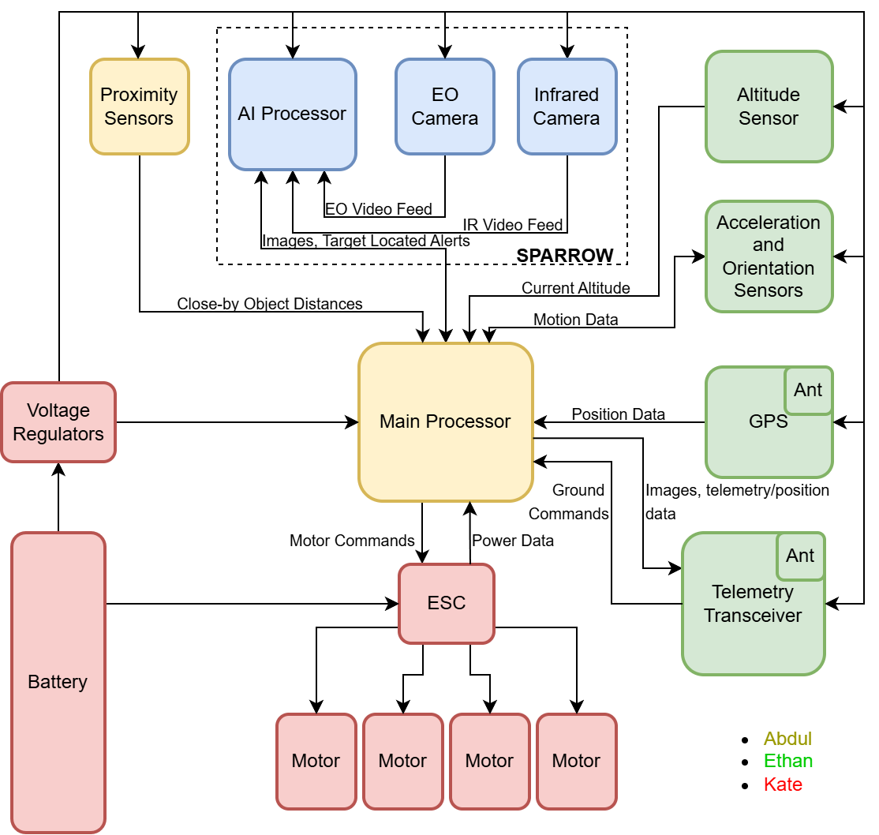
Hardware Block Diagram
All located on X-frame quadcopter drone chassis

Slide 10
Drone Sensor Package Configuration
Sensor | Drone 1 | Drone 2 | Drone 3 | Drone 4
LiDAR | Yes | Yes | No | Yes
EO Camera | Yes | Yes | Yes | No
IR Camera | Yes | No | No | Yes

Slide 11
Electrical Design
The Following Slides Discuss
Technology Selection
Product Selection

Slide 12
IMU Technology Selection
Accelerometers
Gyroscope
Magnetometer
Criteria | MEMS | Quartz
Detection Precision | Moderate | High
Detection Accuracy | High | High
Detection Range | Moderate | High
Cost | Low | High
Environmental Robustness | Moderate | High
Multi direction of Acceleration capable | High | N/A
Size of the package | Low | High
Criteria | MEMS | RLG
Detection Precision | Moderate | High
Detection Accuracy | High | High
Detection Range | High | High
Cost | Low | High
Size | Low | High
Environmental Robustness | Moderate | High
Criteria | MEMS | Fluxgate
Size | Low | High
Cost | Low | High
Power Consumption | Low | Moderate
Orientation Accuracy | Moderate | High
Orientation Precision | Moderate | High
Measurement Range | High | High
Environmental Robustness | Moderate | High

Slide 13
IMU Product Selection
Criteria | ICM-20948 | BNO055 | ISM330BXTR
Data Resolution | 16 bit | 16 bit | 16 bit
Output Data Rate | 1.1ksps | 100sps accelerometer and gyroscope, 20 sps magnetometer | 3.84ksps
Package Type | QFN | LGA | LGA
Sensors Available | Accelerometer, Gyroscope, Magnetometer | Accelerometer, Gyroscope, Magnetometer | Accelerometer, Gyroscope
Interface Protocol | SPI,I2C | I2C,UART | SPI,I2C
Power Consumption | 5.6mW | 37.5mW | 1.6mW
Price | $8.43 | $15.37 | $7.54

Slide 14
Proximity Sensor Technology Selection
Criteria | Ultrasonic Sensor | LiDAR | RADAR
Environmental Robustness | Low | Moderate | Very High
Detection Speed | Moderate | High | Very High
Detection Accuracy | Low | High | Moderate
Ease of Data Transfer | High | Moderate | High
Price | Very Low | Moderate | High
Size | Very Low | Moderate | Low
Power Consumption | Very Low | High | Moderate

Slide 15
LiDAR Product Selection
Criteria | RPLIDAR C1 | TFmini Plus | LDROBOT D300
Size | 55.6x55.6x41.3mm | 35x18.5x21mm | 38.59x38.59x33.5mm
Weight | 110g | 12g | 47g
Detection Resolution | 15mm | 1cm | 15mm
Detection Speed | 5000 Points per Sample, 10 Samples per second | 1 ksps | 4500 Points per Sample, 13 Samples per Second
Detection Range | 12m | 12m | 12m
Environmental Robustness | IP65 | IP65 | IP65
Protocol | UART | I2C/UART | UART
Price | $69.00 | $52.90 | $120
Power Consumption | 1.15W | 700mW | 900mW
Ambient Light Immunity | 40 Klux | 70 Klux | 30 Klux

Slide 16
Radar Product Selection
Criteria | XM132 | C4001 | MR24HPB1
Size | 25x20mm | 26x30mm | 35x30mm
Is it a standalone module | No | Yes | Yes
Detection Speed | N/A | N/A | 500ms
Detection Range | 7m | 1.2-25m | 12m
Detection Field of View | 90 horizontal 60 vertical | 100 horizontal 40 vertical | 90 horizontal 60 vertical
Protocol | UART and I2C | UART | UART
Price | $19.73 | $13.90 | $19.9
Power Consumption | 8.839mW | 450mW | 100mW
Number of Rx and Tx Ant | 1 | 4 | 4

Slide 17
GPS Product Selection
Criteria | XA1110 | VK2828U7G5LF | M8Q-0-10
Channels | 56 | 56 | 72
Update Rate | Up to 10 Hz | Up to 10 Hz | Up to 18 Hz
Sensitivity | -165 dBm | -162 dBm | -167 dBm
Built-in Antenna | No | Yes | Yes
External Antenna Support | Yes | No | Yes
Interfaces | UART, I2C | UART | UART, I2C
Power Consumption | Low | Medium | Medium
Operating Voltage | 3.3 - 5V | 3.3 - 5V | 3.3 - 5V

Slide 18
RF Transceiver Product Selection
Specification | 3DR SiK Air Telemetry Radio | Holybro SiK Telemetry Radio V3 | Holybro Microhard Radio
Range | >300 meters | >300 meters | <60 kilometers
Sensitivity | -121 dBm | -117 dBm | <-107 dBm
Transmit Power | 100 mW | 100 mW | 100 mW - 1 W
Data Rate | <250 kbps | Unknown | <230.4 kbps
Operating Voltage | 3.3V - 5V | 3.3V - 5V | 7 - 35 V
Weight | 14.3g without antenna | 13.6g without antenna | 42g without antenna
 | 22.24g with antenna | 23.1g with antenna | 69g (with antenna)
Power Consumption | Low | Low | High
Cost | $68.90 | $58.99 | $229.00

Slide 19
Altimeter Technology Selection
Criteria | Ultrasonic | LiDAR | Barometric
Range | Low | Low - High | High
Accuracy | Moderate | High | High
Environmental Sensitivity | Low | Moderate | Low
Response Time | High | Low | Low
Power Consumption | Moderate | High | Low
Weight | Moderate | High | Low
Cost | Low | High | Low

Slide 20
Altimeter Product Selection
Criteria | BMP390 | LPS22HH | BMP581
Accuracy | ±0.5 m | ±1.0 m | ±0.3 m
Current Draw | 3.4 μA | 4 μA | 2 μA
Operating Voltage | 1.65V - 3.6V | 1.7V - 3.6V | 1.65V - 3.6V
Interfaces | SPI, I2C | SPI, I2C | SPI, I2C
Dimensions | 2.0mm x 2.0mm x 0.75mm | 2.0mm x 2.0mm x 0.73mm | 2.0mm x 2.0mm x 0.8mm
Pressure Range | 30kPa - 125kPa | 26kPa - 126kPa | 30kPa - 125kPa
Operating Temperature | -40°C - 85°C | -40°C - 85°C | -40°C - 85°C
Cost | $4.13 | $3.62 | $4.13

Slide 21
Processor Technology Selection
Criteria | MCU | FPGA
Power Consumption | Low | High
Ease of Use | High | Low
Cost | Low | High
Documentation | Yes | No
Flexibility | No | Yes
Real-Time Processing | High | Very High
Scalability | Low | High
Environmental Robustness | High | Low
Parallel Processing | Low | High
Latency | Moderate | Low
Peripheral Support | High | Low

Slide 22
Processor Product Selection
Criteria | ESP32-WROOM-32 | ESP32-S2 | STM32H743 | STM32F769I-Discovery
Processor | Dual-core Tensilica LX6 | Xtensa LX7 | ARM Cortex-M7 | ARM Cortex-M7
Clock Speed | Up to 240 MHz | Up to 240 MHz | Up to 480 MHz | Up to 216 MHz
RAM | 520 KB | 320 KB | 1 MB | 512 KB
Flash Memory | 4 MB | 4 MB | 2 MB | 2 MB
Connectivity | Wi-Fi, Bluetooth | Wi-Fi, Bluetooth | USB, SPI, I2C, UART, CAN | Ethernet, USB, SPI, I2C, UART
UART | Yes | Yes | Yes | Yes
I2C | Yes | Yes | Yes | Yes
SPI | Yes | Yes | Yes | Yes
PWM | Yes | Yes | Yes | Yes
ADC | Yes | Yes | Yes | Yes
DAC | Yes | No | Yes | Yes
Power Consumption | Low | Low | Moderate | Moderate

Slide 23
Motor Technology Selection
Criteria | Brushed DC | Brushless DC | Coreless | SRM
Weight | Moderate | High | Extremely Low | Moderate
Power Consumption | High | Low | Moderate | Moderate
Torque Output | Moderate | High | Moderate | Moderate
Durability | Low | High | Low | Extremely High
Efficiency | Low | High | Moderate | High
Speed Control | Moderate | Extremely High | High | Moderate
Complexity of Control | Low | Moderate | Low | Extremely High
Maintenance Requirements | High | Low | Moderate | Low
EMI Resistance | Low | High | Moderate | Extremely High
Temperature Tolerance | Moderate | High | Low | High
Lifespan | Low | High | Moderate | Extremely High
Cost | Low | High | Low | Extremely High

Slide 24
Motor Product Selection
Criteria | T-motor U7 | SunnySky X4110S | Emax GT5345 | Propdrive 3542
KV Rating | 420 KV | 400 KV | 220 KV | 900-1000 KV
Motor Size and Weight | 60.7 x 39.5mm, 296g | 47.5 x 37.5 mm, 165g | 52 x 45 mm, 850g | 64 x 35 mm, 155g
Thrust Output | 4.64kg | ~2kg | ~10kg | ~2kg
Voltage Range | 3-8S | 6S | 8-12S | 3-4S
Current Draw | 40A | 45A | 80A | 52A
Operating Temperature | 45-47 ℃ | 53 ℃ | N/A | N/A
Efficiency | High | High | Moderate | High
Durability | Very High | High | Very High | Moderate
Quality | Very High | High | High | Moderate
ESC Compatibility | Very High | High | Very High | Low
Company Reputability | Very High | High | High | Moderate
Cost | $149.90 | $46.99 | $80.40 | $31.99

Slide 25
Motor Controller Protocol Technology Selection Pt. 1
Criteria | PWM | OneShot125 | Multishot | D-shot
Speed | Low | Moderate | Very High | High
Precision | Low | Moderate | High | Very High
Latency | High | Moderate | Low | Very Low
Signal Reliability | Low | Low | Low | Very High
Hardware Compatibility | Very High | Moderate | Low | Low - Moderate
Setup Complexity | Very Low | Low | High | Moderate
Power Efficiency | Moderate | Moderate | Low | High
Error Detection | Very Low | Very Low | Very Low | Very High

Slide 26
Motor Controller Configuration Technology Selection Pt 2.
Criteria | 1-for-1 | 2-in-1 | 4-in-1
Space Efficiency | Low | Moderate | High
Weight Savings | Low | Moderate | High
Wiring Simplicity | Low | Moderate | High
Setup Complexity | Moderate | Moderate | Low
Heat Management | High | Moderate | Low
Ease of Maintenance | High | Moderate | Low
Flexibility in Replacement | Very High | Moderate | Very Low
Failure Impact | Very Low | Moderate | Very High
Cost | Low | Moderate | High

Slide 27
Motor Controller Product Selection
Criteria | T-Motor F55A Pro II | Lumenier Elite Pro | SpeedyBee 60A
Continuous Current | 55A | 60A | 60A
Burst Current | 75A | 100A | 70A
Voltage Rating | 3-6S LiPo | 2-6S LiPo | 3-6S LiPo
BEC Output | 10V @ 2A | No | No
Protection | Yes (Over-Current, Over-Temperature, Low-Voltage) | Yes (Over-Current), | Yes (Surge)
Speed | DShot 1200 (BLHeli32) | Dshot1200 (BLHeli32) | DShot600 (BLHeli_S)
Weight | 17.5g | 27g | 10.5g
Ardupilot Compatibility | Yes | Yes | Yes
Dshot600 Compatibility | Yes | Yes | Yes
Cost | $93.90 | $84.99 | $75.99

Slide 28
Power Tree
Hardware Component | Supply Voltage | Max Current Draw | Max Power
LiDAR | 5 V | 260 mA | 1.3 W
RADAR | 5V | 100 mA | 0.5 W
Thermal Camera | 3.3 V | ~550 mA | ~1.8 W
Regular Camera | 5 V | 210 mA | 1.05 W
Motor | 22.2 V | 45 A | 1125 W
Motor Controllers | 22.2V | 200 A | 4440 W
Radio | 5V | 300mA | 1.5 W
GPS | 2.7 V – 3.6 V | 67mA | 0.24 W
IMU | 1.8V | 3.11mA | 5 mW
Altimeter | 1.65 V – 3.6 V | 1.3 µA | 4.68 µW
MCU | 19V | 3.15 A | 60 W
Processor | 3.3V | 620mA | 2.05W
Five distinct voltage level requirements
  22.2V
  19V
  5V
  3.3V
  1.8V
22.2V directly powered by battery
Must select four voltage regulators

Slide 29
Voltage Regulator Technology Selection
Researched both linear voltage regulators and switching voltage regulators
Linear regulators were decided for 1.8V
  Low-noise
  Steady supply
  Low voltage drop off (1.5V)
Switching regulators were decided for 3.3V, 5V, and 19V
  Highly efficient
  Current capacity
  Significant voltage drop off

Slide 30
1.8V Linear Voltage Regulator Selection
Criteria | LP5907MFX-1.8 | LM317MQDCYR | MIC5504-1.8YM5
Input Voltage Range | 2.2V - 5.5V | 3V - 40V | 2.5V - 5.5V
Output Voltage | 1.8V | 1.25V - 37V | 1.8V
Drop-Out Voltage | ~250mV at 250mA | ~2V at Full Load | ~160mV at 300mA
Max Output Current | 250 mA | 500 mA | 300mA
Power Dissipation | ~0.375W | ~0.75W | ~0.45W
Noise | 10µVRMS | 38µVRMS | 30µVRMS
Package Type | SOT-23-5 | SOT-223 | SOT-23-5
Protection Features | Short-circuit, thermal shutdown | Overcurrent, thermal shutdown | Thermal shutdown, current limit
Cost | $0.49 | $0.58 | $0.16

Slide 31
3.3V and 5V Switching Voltage Regulator Selection
Criteria | AP64501SP-13 | TPS566247DRLR | TPS54531DDAR
Input Voltage Range | 3.8V - 40V | 3V - 16V | 3.5V - 28V
Output Voltage | 0.8V to 32V | 0.8V to 5V | 0.8V to 5V
Max Output Current | 5A | 6A | 5A
Efficiency | Up to 90% | Up to 98% | Up to 95%
Switching Frequency | 500kHz | 1.4MHz | 570kHz
Package Type | SO-8EP | SOT-563 | SOT-23
Protection Features | Short circuit, under-voltage, over-temperature, over current | Over-voltage, over-current, over-temperature | Over-current, frequency foldback, over-temperature
Cost | ~$3.22 | ~$0.81 | ~$1.89
Experience | Yes | No | No
Notes:
Both chosen to be the same component to maintain consistency

Slide 32
19V Switching Voltage Regulator Selection
Criteria | DC 24V Buck Module | DC-DC Buck Converter Module | UCC14240QDWNRQ1
Input Voltage Range | 22V - 40V | 4V - 38V | 21V - 27V
Output Voltage | 19V | 1.25V - 36V | 18V - 25V
Max Output Current | 5A | 5A | 0.1A
Efficiency | 96% | 96% | High
Switching Frequency | N/A | N/A | High
Noise | N/A | N/A | Low
Size/Weight | 2.91"D x 2.91"W x 1.25"H, 244g | 2.36*1.41*0.7" 30g | 0.51" L x 0.30" W x 0.14" H
Protection Features | Over/Under Voltage Input, Overload, Overheat, Short Circuit | Thermal | Soft Start, Short Circuit, Power Limit, Under Voltage, Overvoltage, Over-Temperature
Cost | $17.19 | $7.99 | $9.57

Slide 33
Battery Technology Selection
Criteria | Li-Po | Li-Ion | NiCd
Energy Density (Wh/kg) | 150-200 | 200-300 | 40-60
Discharge Rate (C) | 30-100 | 1-3 | 10-20
Nominal Cell Voltage (V) | 3.7 | 3.7 | 1.2
Weight (g) | 200-300 | 250-400 | 500-800
Shape and Size | Thin and flexible | Cylindrical and fixed | Bulky
Recharge Rate | 1-2 Hours | 2-4 Hours | Less than 1 hour
Circuit Protection | Needed | May be Needed | Needed
Thermal Stability | Risk | Stable | Very Stable
Cost (Per Pack) | $30-80 | $40-100 | $10-30

Slide 34
Battery Product Selection
Criteria | Tattu 6S | Zeee 6S | Spektrum 4S
Capacity (mAh) | 4500 | 6000 | 5000
Discharge Rate (C) | 25 | 100 | 1
Weight (g) | 670 | 833 | 515
Dimensions (mm) (L x W x H) | 137 x 42 x 50 | 155.5 x 48.5 x 51.5 | 148 x 46 x 35
Voltage (V) | 22.2 | 22.2 | 14.8
Connector | XT60 | EC5 | IC5
Cost | $108.19 | $88.99 | $99.99

Slide 35
Power Management
Hardware Component | Supply Voltage | Max Current Draw | Max Power
LiDAR (RPLIDAR C1) | 5 V | 260 mA | 1.3 W
RADAR (C4001) | 5V | 100 mA | 0.5 W
Thermal Camera (FLIR) | 3.3 V | ~550 mA | ~1.8 W
Regular Camera (ELP USB 3.0) | 5 V | 210 mA | 1.05 W
Motor (X4110S) | 22.2 V | 45 A | 1125 W
Motor Controllers (F55A Pro II) | 22.2V | 200 A | 4440 W
Radio | 5V | 300mA | 1.5 W
GPS (SAM-M8Q) | 2.7 V – 3.6 V | 67mA | 0.24 W
IMU (ICM-20948) | 1.8V | 3.11mA | 5 mW
Altimeter (BMP581) | 1.65 V – 3.6 V | 1.3 µA | 4.68 µW
MCU (Jetson) | 19V | 3.15 A | 60 W
Processor (STM32H743Z1) | 3.3V | 620mA | 2.05W
BATTERY (Tattu 4500mAh 6s)
Max Current Draw:
  54 to 77 amps
Minimum Voltage Input:
  Approximately 22V
Batteries Needed
  2
Flight Time:
  Approximately 13 minutes

Slide 36
Voltage Translator Technology Selection
Criteria | Level Shifter | MOSFET | Resistors
Signal Speed | High | Low | Low
Number of Channels per Unit | Variable | 1 | 1
Ease of Use and Integration | High | Moderate | Moderate
Signal Direction | Variable | Unidirectional | Unidirectional
Cost | Moderate | Low | Very Low

Slide 37
Voltage Translator Product Selection
Specification | TXB0304 | LSF0204QPWRQ1 | TXB0108
ESD Protection | Yes | No | Yes
Number of Channels (bits) | 4 | 4 | 8
Maximum Data Rate | 100 Mbps | 100 Mbps | 100 Mbps
Low Voltage Range | 0.9V – 3.6V | 0.95V - 3.3V | 1.2V - 3.6V
High Voltage Range | 0.9V – 3.6V | 1.8V - 5.5V | 1.65V - 5.5V
Temperature Range | -40°C - 85°C | -40°C - 125°C | -40°C - 85°C
Cost (Per Unit) | $0.93 | $1.03 | $1.41

Slide 38
Electrical Hardware
The Following Slides Discuss
Block Diagrams
Schematics
PCB Design

Slide 39
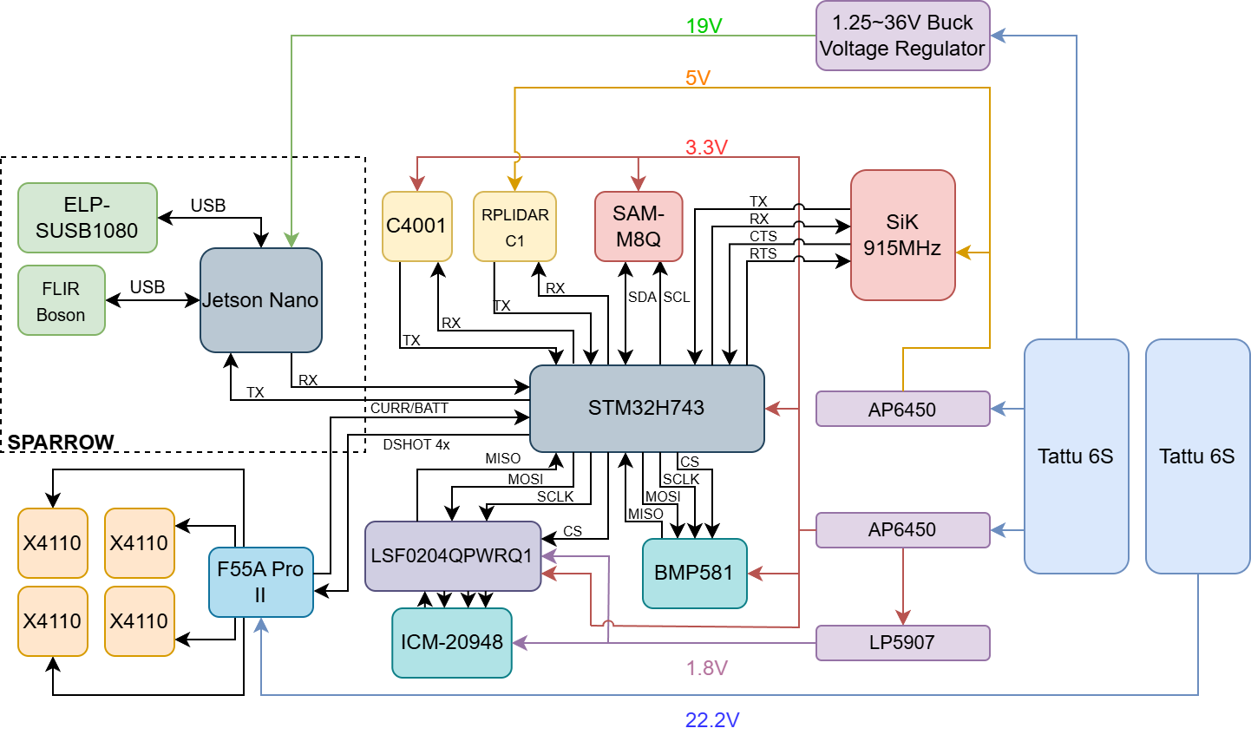
Electrical Subsystem Architecture
Power Rails: 22.2V, 19V, 5V, 3.3V, 1.8V
Communication: MAVLINK, SPI, I2C, UART, DSHOT, Analog
External Interfaces: MAVLINK to SPARROW, MAVLINK to Ground Station.
Sensors: IMU (ICM-20948), Altimeter (BMP581), LiDAR (RPLIDAR C1), RADAR (C4001)

Slide 40
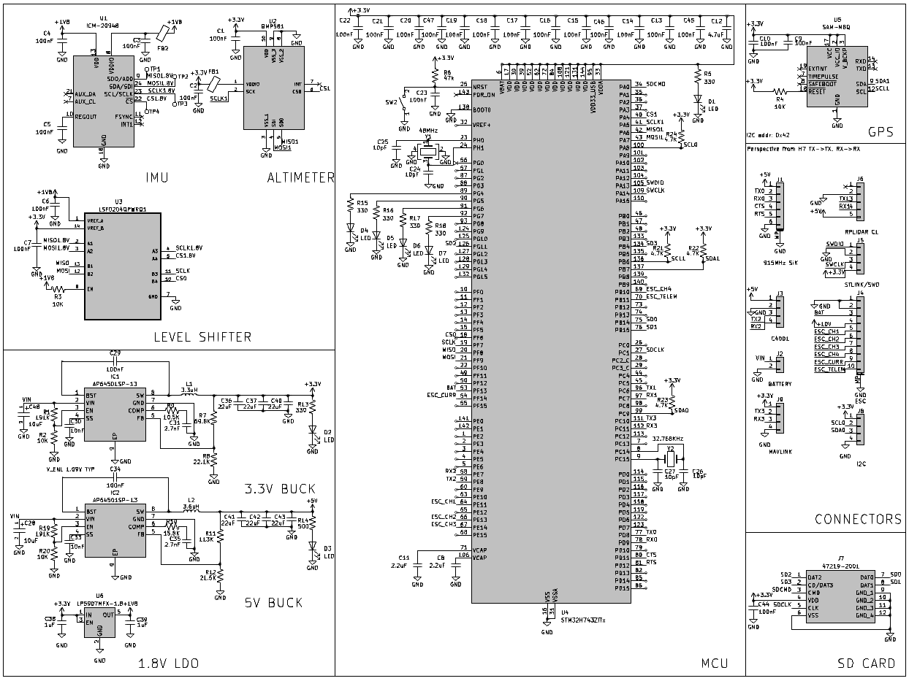
Electrical Design Overall Schematic

Slide 41
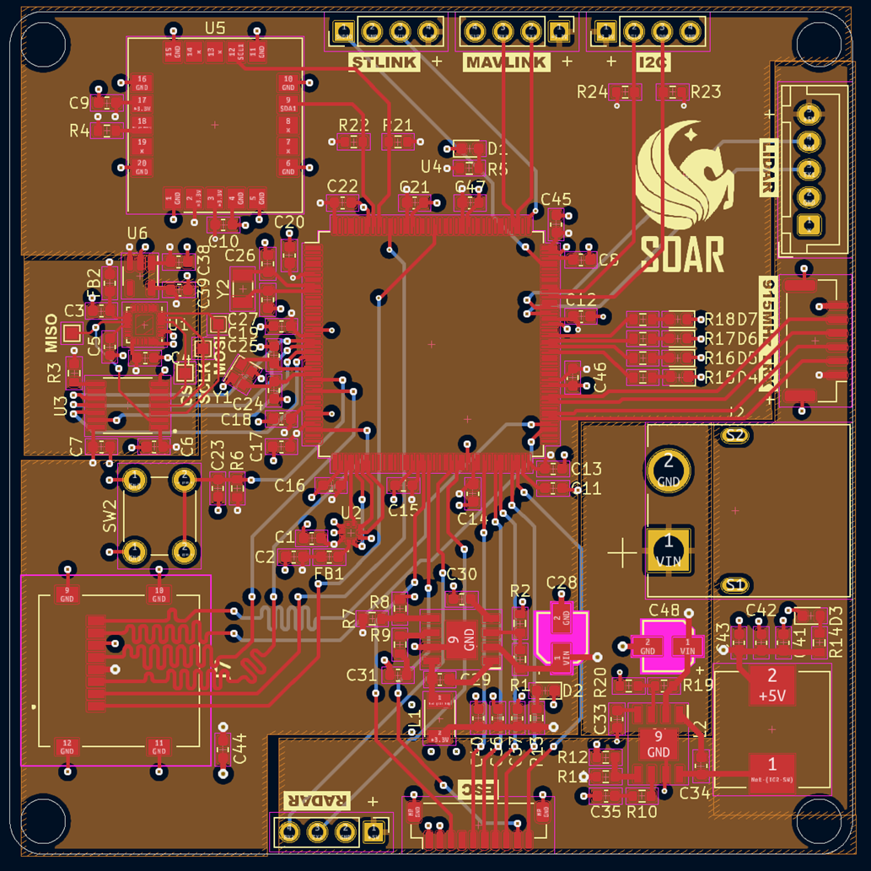
PCB Design
The flight computer PCB integrates the MCU, GPS, IMU, altimeter, power regulation, and SD card reader all onto one board.
Minimizes size, weight, and cost.
Potential drawbacks are in the event of a power regulation failure all on-board components could be damaged, hard to manufacture by hand which could drive up cost.
Notes:
Minimizes cost by decreasing the amount of boards needed to be purchased. Same components just put on separate pre-assembled boards (major increase in cost).

Slide 42

PCB Design Continued
Hi Chan :)
Layer Stackup
Top - Signal
Middle 1 - Gnd
Middle 2 - Pwr
Bottom - Signal

Slide 43
Software and Communication
The Following Slides Discuss
Drone Automation Software
Wireless Communication

Slide 44
Drone Automation Software Selection
Criteria | ArduPilot | PX4 | DroneKit | Paparazzi UAV | CleanFlight
Development Language | C / C++ | C / C++ | Python, Android | C | C
Mission Planning | High | High | Moderate | High | Low
Real-time Telemetry | Yes | Yes | Yes | Yes | Yes
Ease of Use | Moderate | Moderate | High | Moderate | High
Sensor Integration | High | High | Moderate | High | Moderate
Autonomous Navigation | High | High | Moderate | High | Low
Modularity and Customization | High | High | High | High | Moderate

Slide 45
Wireless Communication Method
Technology Selection
Criteria | Wi-Fi | Bluetooth | Radio
Range | Low | Low | High
Data Rate | Fast | Slow | Slow
Power | High | Medium | Low

Slide 46
Wireless Communication Method
Product Selection
Criteria | LoRaWAN | Zigbee | APRS | MAVLink
Range | 15km | 100m | 10km - 30km | <10km
Data Rate | 22 kbps | 250 kbps | 1.2 kbps | 9.6 kbps - 57.6 kbps
Power | Low | Low | Low | Low
Operating Frequency | 902.3 – 914.9 MHz | 915 MHz/2.4 GHz | 144.39 MHz | 915 MHz

Slide 47
Mechanical Design
The Following Slides Discuss
Technology Selection
Product Selection

Slide 48

Frame System Technology/Product Selection
Criteria | X-Frame | H-Frame | +- Frame | V-Frame
Price | Moderate | Moderate | Moderate | Moderate
Aerodynamics | High | Moderate | Moderate | High
Stability | Moderate-High | High | Low | Moderate-High
Forward thrust | Moderate | Moderate | Moderate | High
Maneuverability | High | Moderate | Low | Moderate-High
Motor Efficiency | High | Moderate | Moderate | High
Weight Distribution | High | Moderate-High | Low-Moderate | Moderate
Durability | High | High | Low | Moderate

Slide 49
Propulsion System Technology Selection
Criteria | Two-Blade | Three-Blade | Four-Blade
Thrust | Low | Moderate | High
Efficiency | High | Moderate | Low
Stability | Moderate | Moderate | High
Weight | Low | Moderate | High
Cost | Low | Moderate | High

Slide 50
Propulsion System Product Selection
Criteria | Quanum 15x5.5 | FLUXER 16.1x6.4 | Eolo 18x6.5
Size | 15x5.5 | 16.1x6.4 | 18x6.5
Weight (single) | 20g | 21±1.5g | 32g
Working Temp | -40℃~65℃ | -40℃~65℃ | -20℃~65℃
Storage Temp | -10℃~50℃ | -10℃~50℃ | -10℃~50℃
Material | CF | CF | CF
Lift | Moderate | Moderate | High
Drag | Low | Moderate | High
Cost (pair) | $12.5 | $44.90 | $79.99

Slide 51
Landing Gear Selection
Criteria | Fixed | Skid-Type | Retractable
Stability | High | Moderate | High
Shock Absorption | Low | Moderate | High
Weight | Low | Moderate | High
Complexity | Low | Moderate | High
Suitability | High | Moderate | Low

Slide 52
Mechanical Hardware
The Following Slides Discuss
Subsystem Design
Calculations

Slide 53
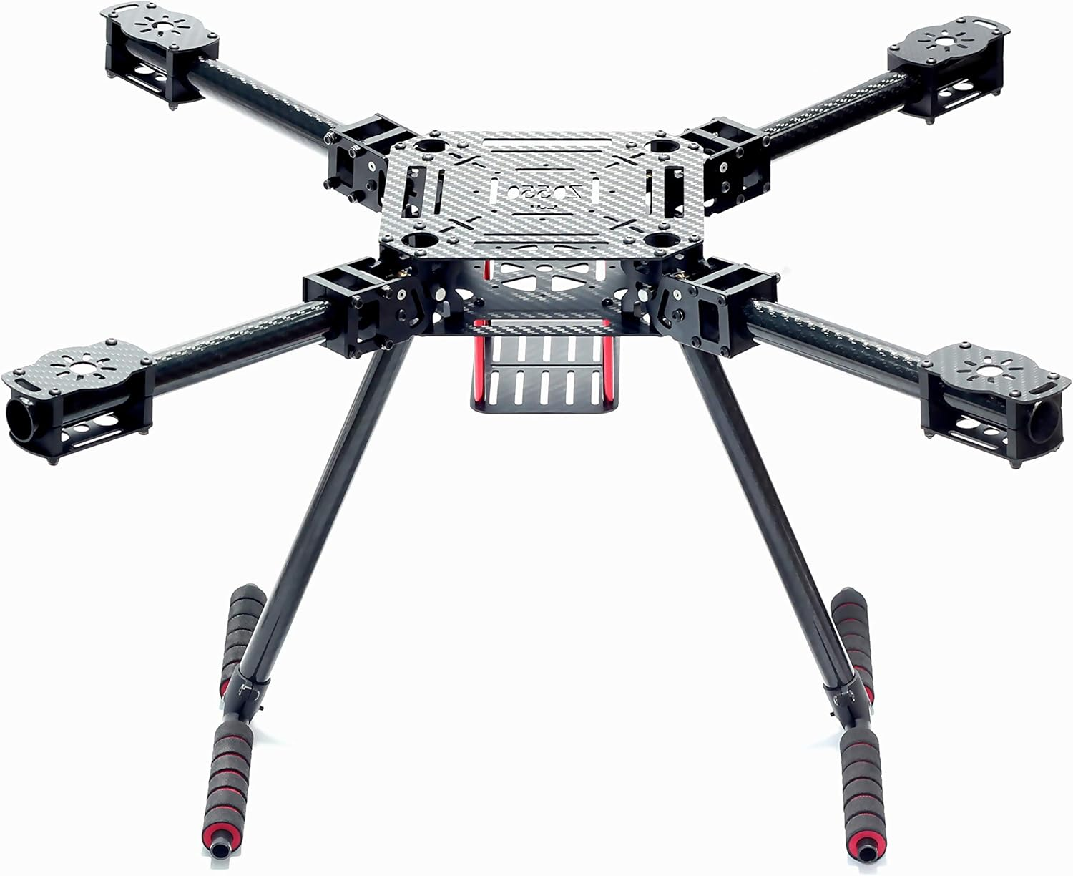
Mechanical Design
Equipped with a Diagonal Wheelbase of 550 mm (21.65 in), allowing for enough room to handle the 15 in x 5.5 in diameter propellers for each arm.
Landing gear height of 260 mm (10.24 in), allowing enough room for the mounted cameras/sensors located at the bottom of the drone to get near total view with a limited amount of blind areas.
Capable of maintaining structural integrity with the payload while maintaining light stature with its 3k full carbon fiber material.
Maintains a low weight of 0.63 kg overall, allowing for the drones lift to weight ratio to maximize.
With the thickness of the main board being 1.5 mm (0.06 in), electronics should be safely located.

Slide 54
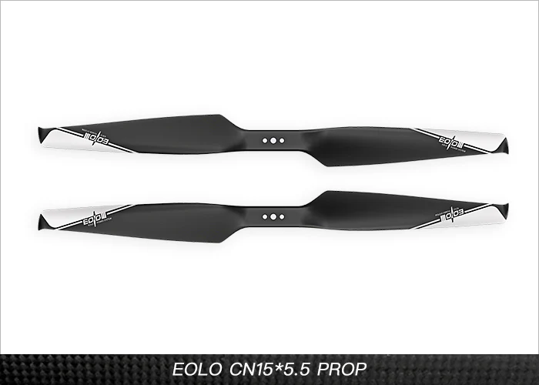
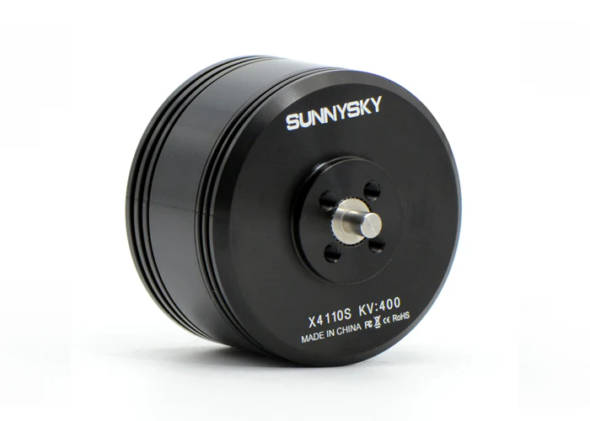
Mechanical Subsystem Design
Propellers are equipped with carbon reinforced nylon, showing to be 3 times tougher than traditional carbon fiber propellers.
Has a max working speed of 8450 rpm, a weight of 21g, size of 15*5.5 in, working temperature of 20-60C, and a dynamic balance value of 3000rpm≤8mg.
The tip of the propeller is designed to minimize vortices, ensuring little turbulence in the air.
The motor has a weight of 165g with a max thrust of 3720g.
Has a max continuous current of 45A/30s and a max continuous power of 1125 W at 400 KV.

Slide 55
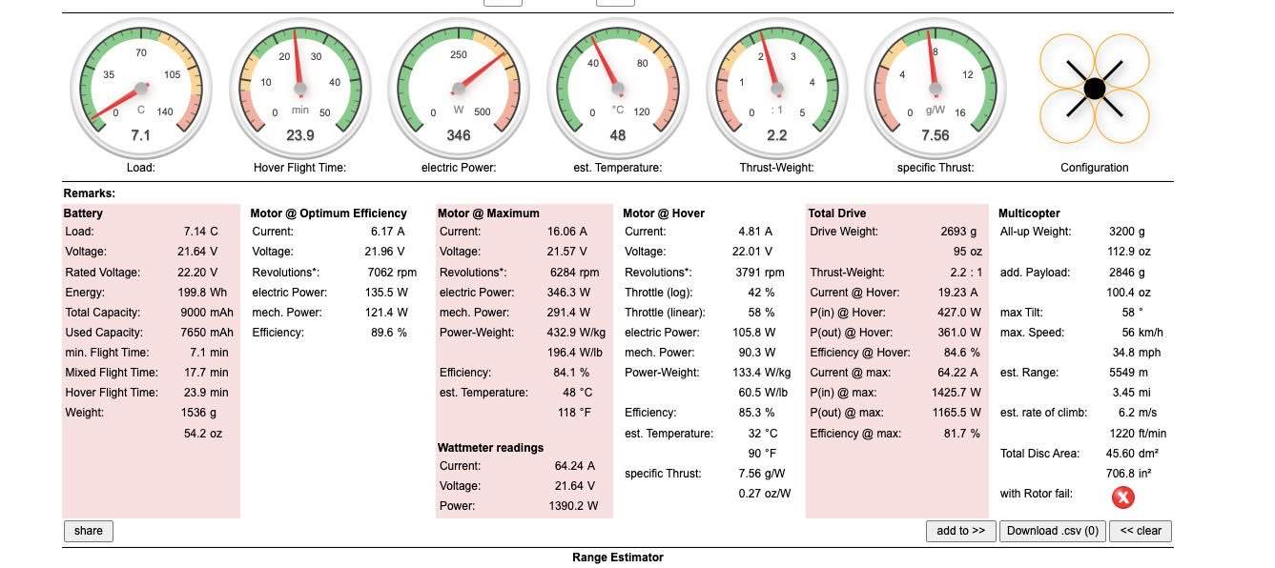
Mechanical Subsystem Calculations
Subsystem Efficiency & Load Analysis

Slide 56
Mechanical Subsystem Calculations
Load | 7.1 Kg
Endurance | 23.9 min
Electric Power | 346 W
Estimated Temperature | 48 C
T/W ratio | 2.2:1
Specific Thrust | 7.56 g/W

Slide 57
Drone Performance
All-Up Weight | 3250 g
Payload | 2850 g
Max Speed | 56 km/h
Range | 5280 m (5.28 km)
Total Disc Area | 45.60 dm²
Disc Loading | 70.6 g/in²

Slide 58
Prototyping and Future plans
The Following Slides Discuss
Altered Design
Further plans

Slide 59
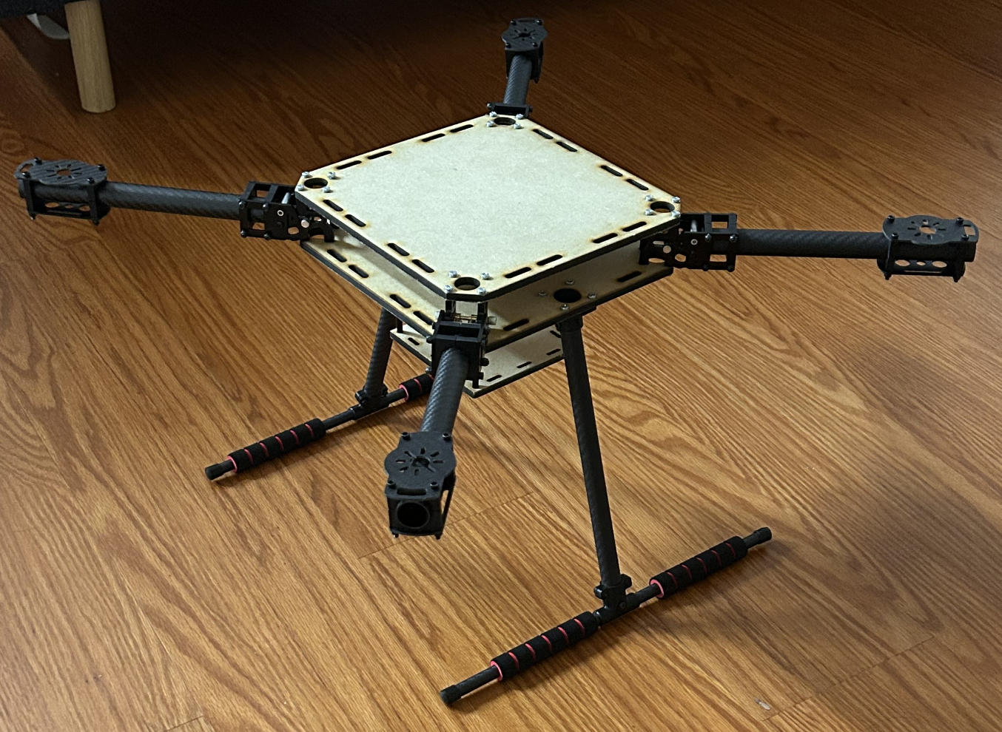
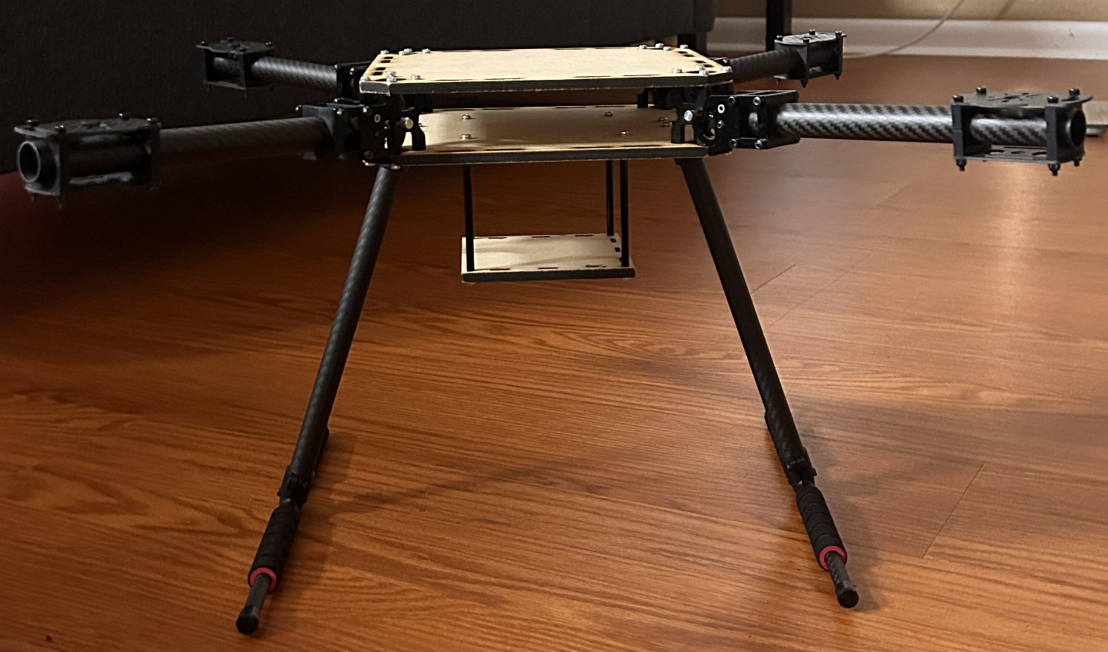
Altered Design
Due to issues with the original kit, new base plates had to be printed to allow for more room. Base plates are now 225x225 mm^2 and the camera mounting station underneath is now 112x112 mm^2. The exact type of wood is mdf ¼ inches and was cut using the C02 Laser cutter located at the UCF TI lab.

Slide 60
Future Plans
Future plans for the MAE team involve:
Creating an enclosure for the electronics placed in the drone to protect against weather or turbulence.
Making brackets for the landing gear of the drone that will cause the shear stress to be more evenly spread across the base plates, eliminating the risk of damage during initial tests.
Properly mounting the electronics within the drone by using standoff screws in the wood.

Slide 61
Software
Design
The Following Slides Discuss
Software Structure
Interfacing

Slide 62
Interface Requirements
SPARROW Interface
Must be able to send commands to and from the ground station.
Must support receiving target sighted alerts.
Must support sending image data fast enough to meet ground station data rate requirements.
Wiring must be secure enough to not come loose during flight.
VITALs Interface
Must be able to receive and transmit commands within range and at the data rate required by the ground station.
Must be power, size, and weight efficient to maximize flight time.
Must be able to support a mesh network between the drone swarm and ground station.
Must support sending image data at the rate required by the ground station.

Slide 63
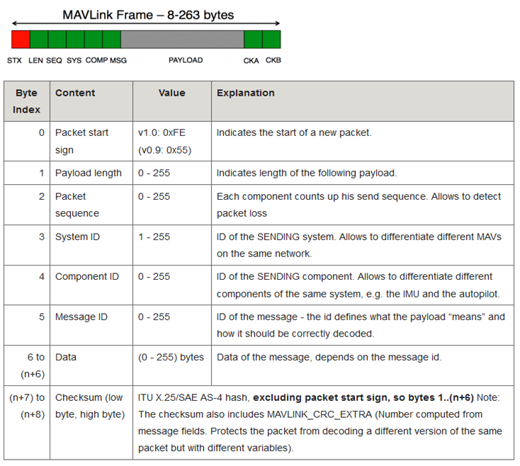
Interface Design
SPARROW/VITALs interface
MAVLink is used as the protocol for both the SPARROW and VITALS interfaces.
MAVLink supports mesh networks through MAVLink nodes on the network retransmitting messages whose target id does not match theirs and broadcast messaging.
MAVLink sends image data by splitting them into chunks before transmission and packet sequence IDs. Requires data transmission handshake before TX.
By using MAVLink for both interfaces, messages received from the ground station can be routed to SPARROW efficiently.

Slide 64
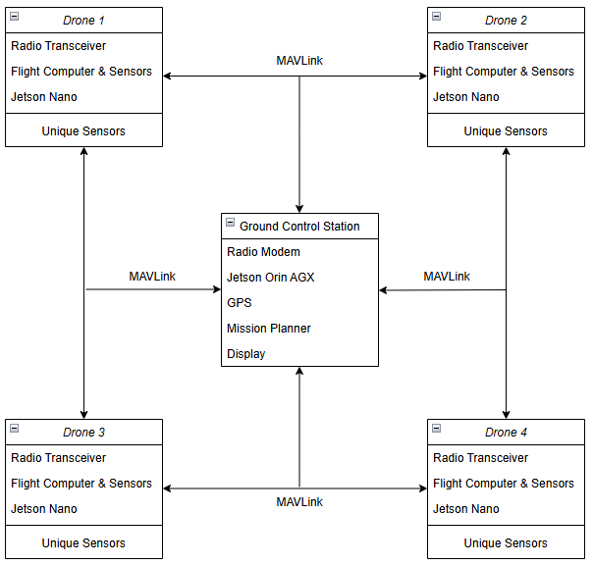
Class Diagram

Slide 65
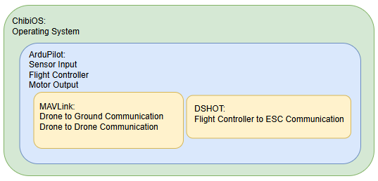
Software Subsystem
The software stack consists of ChibiOS, running ArduPilot. Ardupilot processes sensor input and outputs changes to motors. ArduPilot uses the MAVLink protocol to communicate with the ground station and other drones and DSHOT to send signals to the ESC’s.
Simple stack reduces memory and processor speed requirements.

Slide 66
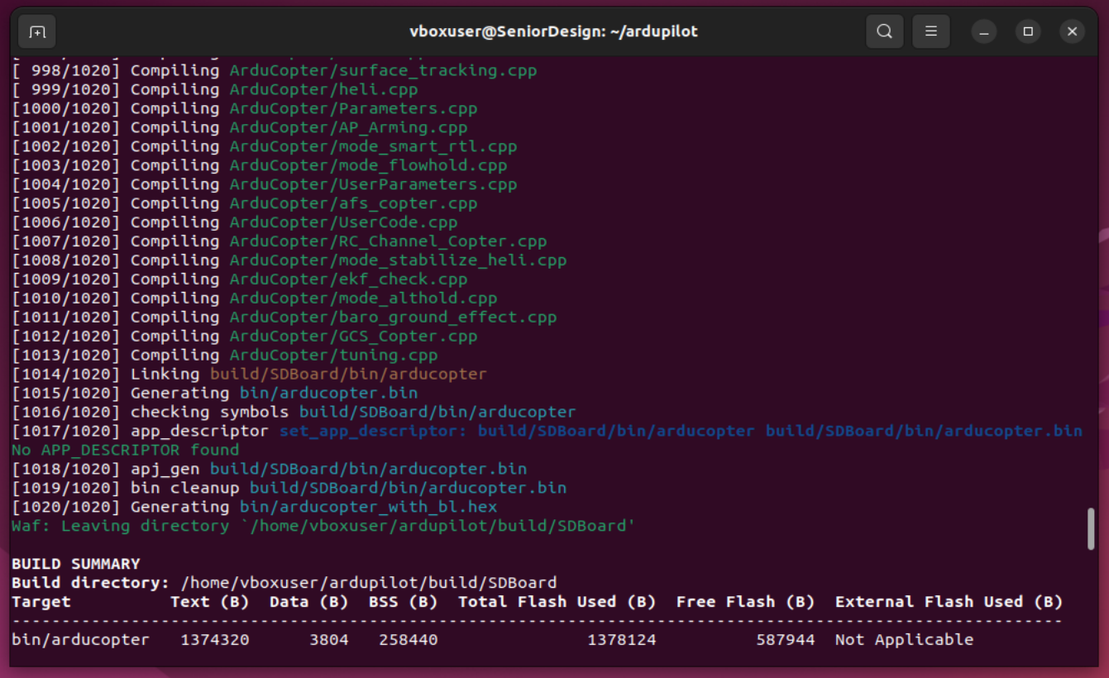
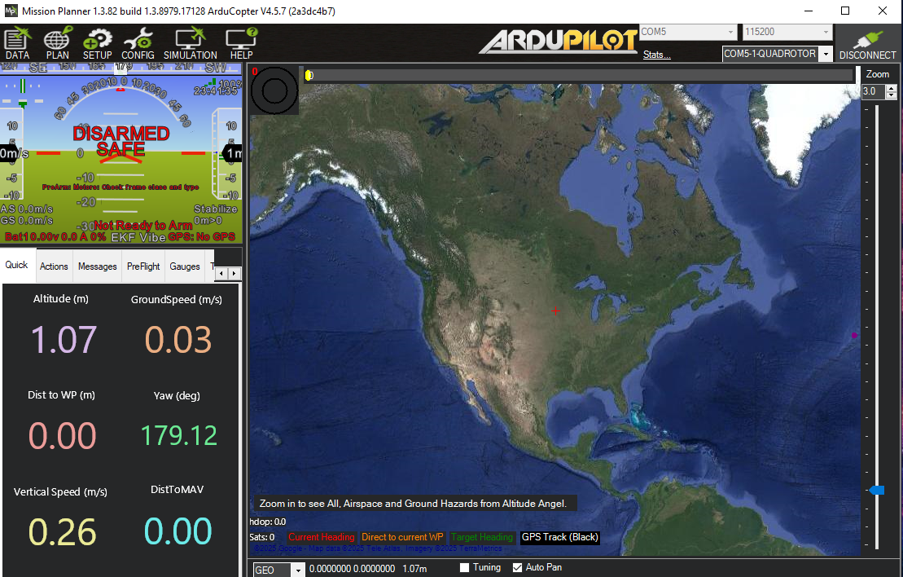
Software Design
Build environment running on a Linux virtual machine.
Pin definitions written and custom firmware built on virtual machine
Custom firmware flashed using STM32Cube Programmer & Mission Planner
Mission Planner utilized for testing and ground control software
Both electrical and software
Can also upload firmware

Slide 67
Prototyping and Testing
The Following Slides Discuss
PCB Testing
ESC Testing
MAVLink Testing

Slide 68
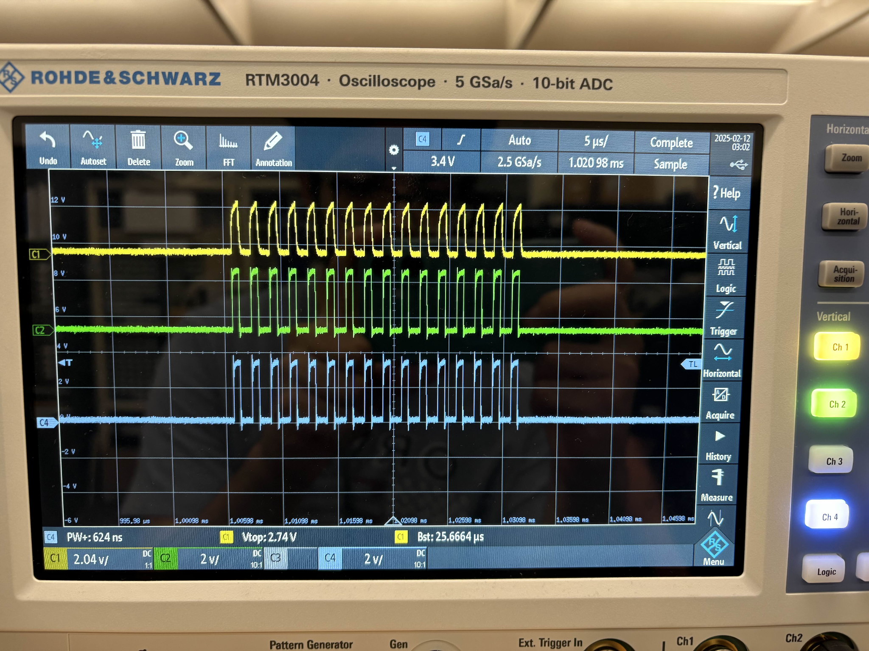
ESC Protocol Testing
Confirmed dshot commands can be sent from COTS flight computer via Ardupilot.

Slide 69
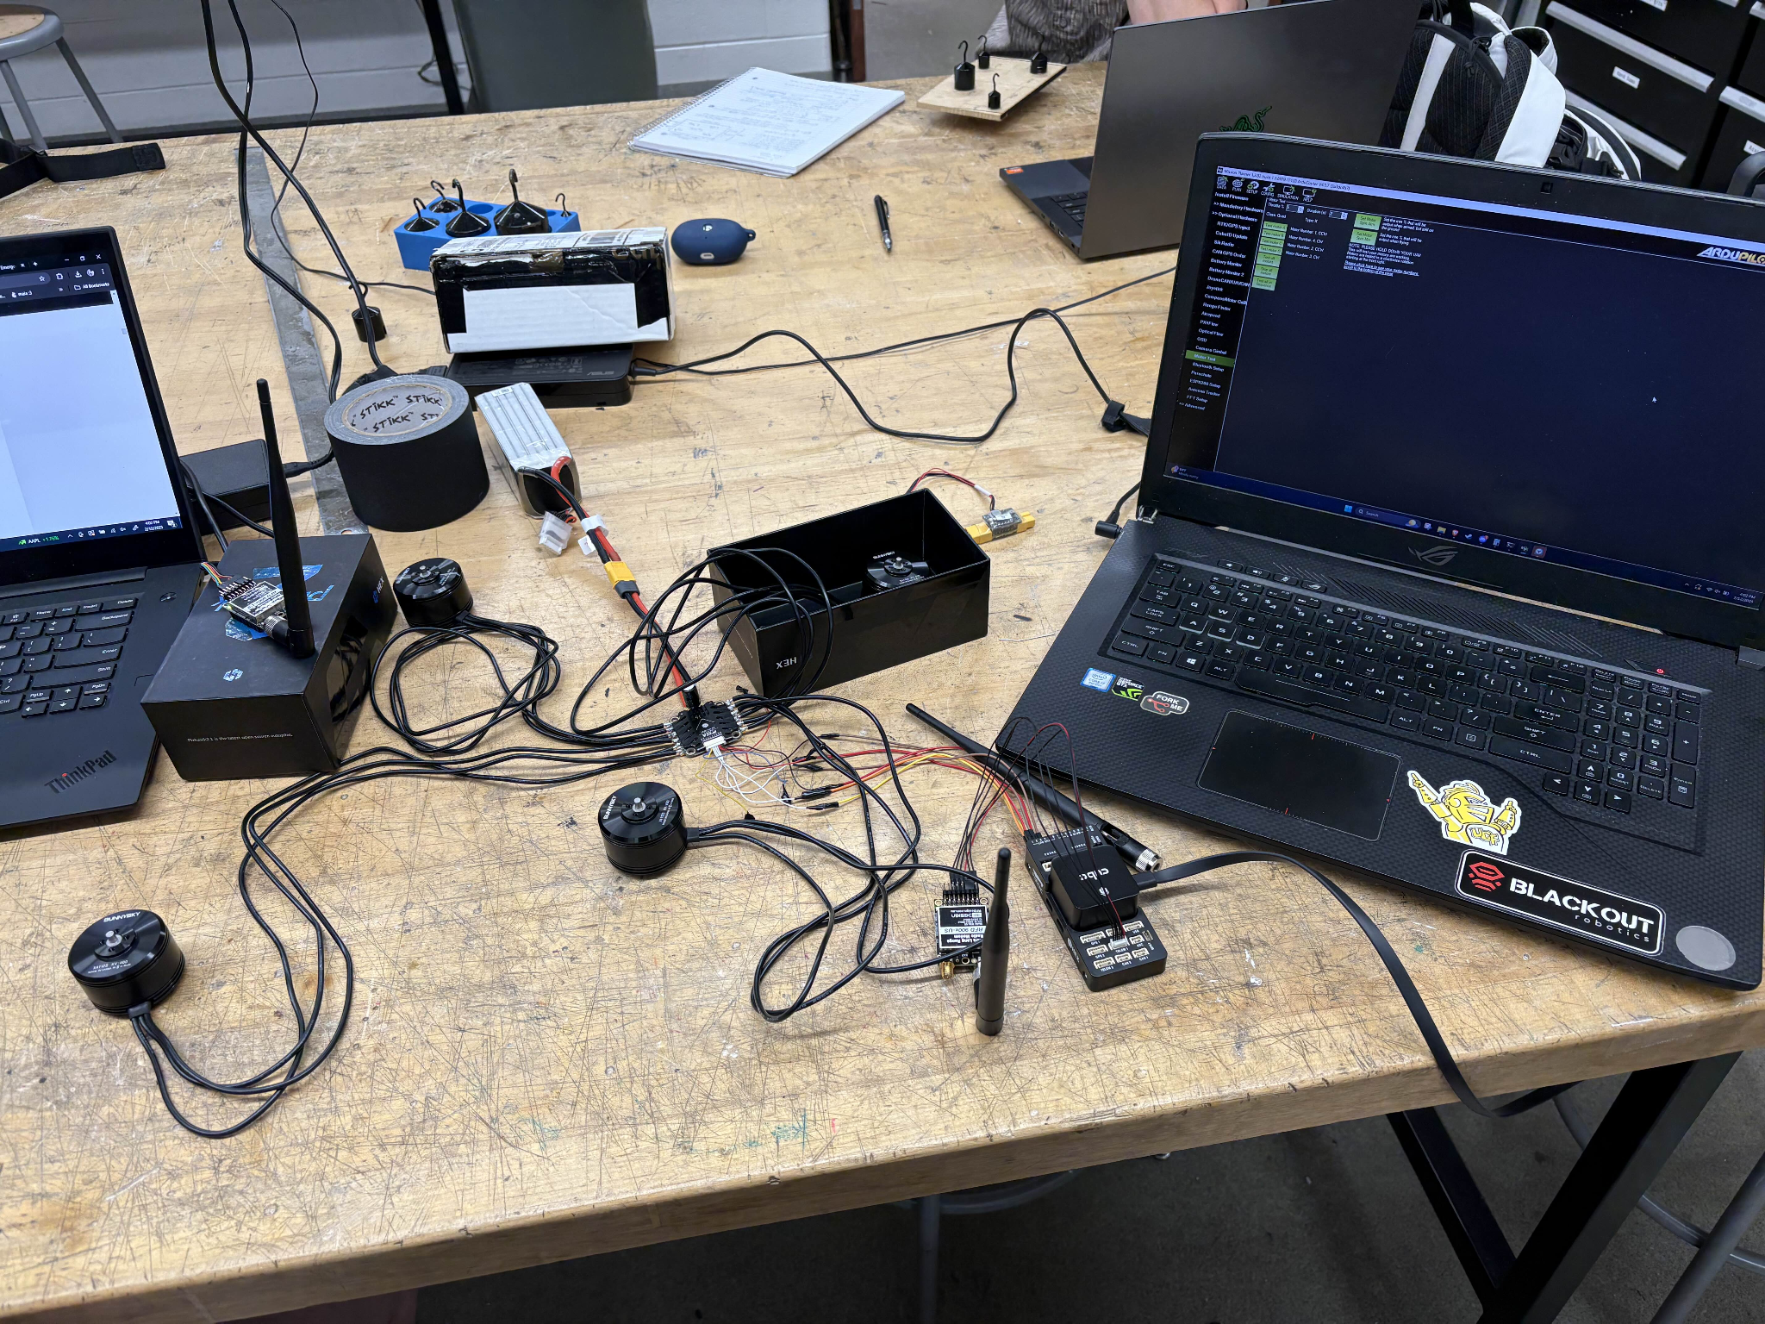
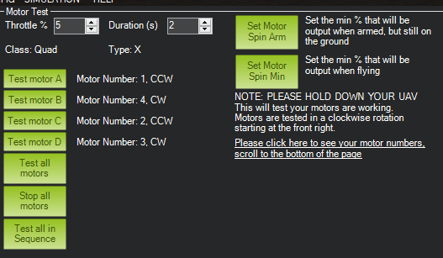
MAVLink and ESC Testing
Tested controlling the motors through the ESC remotely using MAVLink.
Motors were tested for the full range of throttle up to 5 seconds.

Slide 70
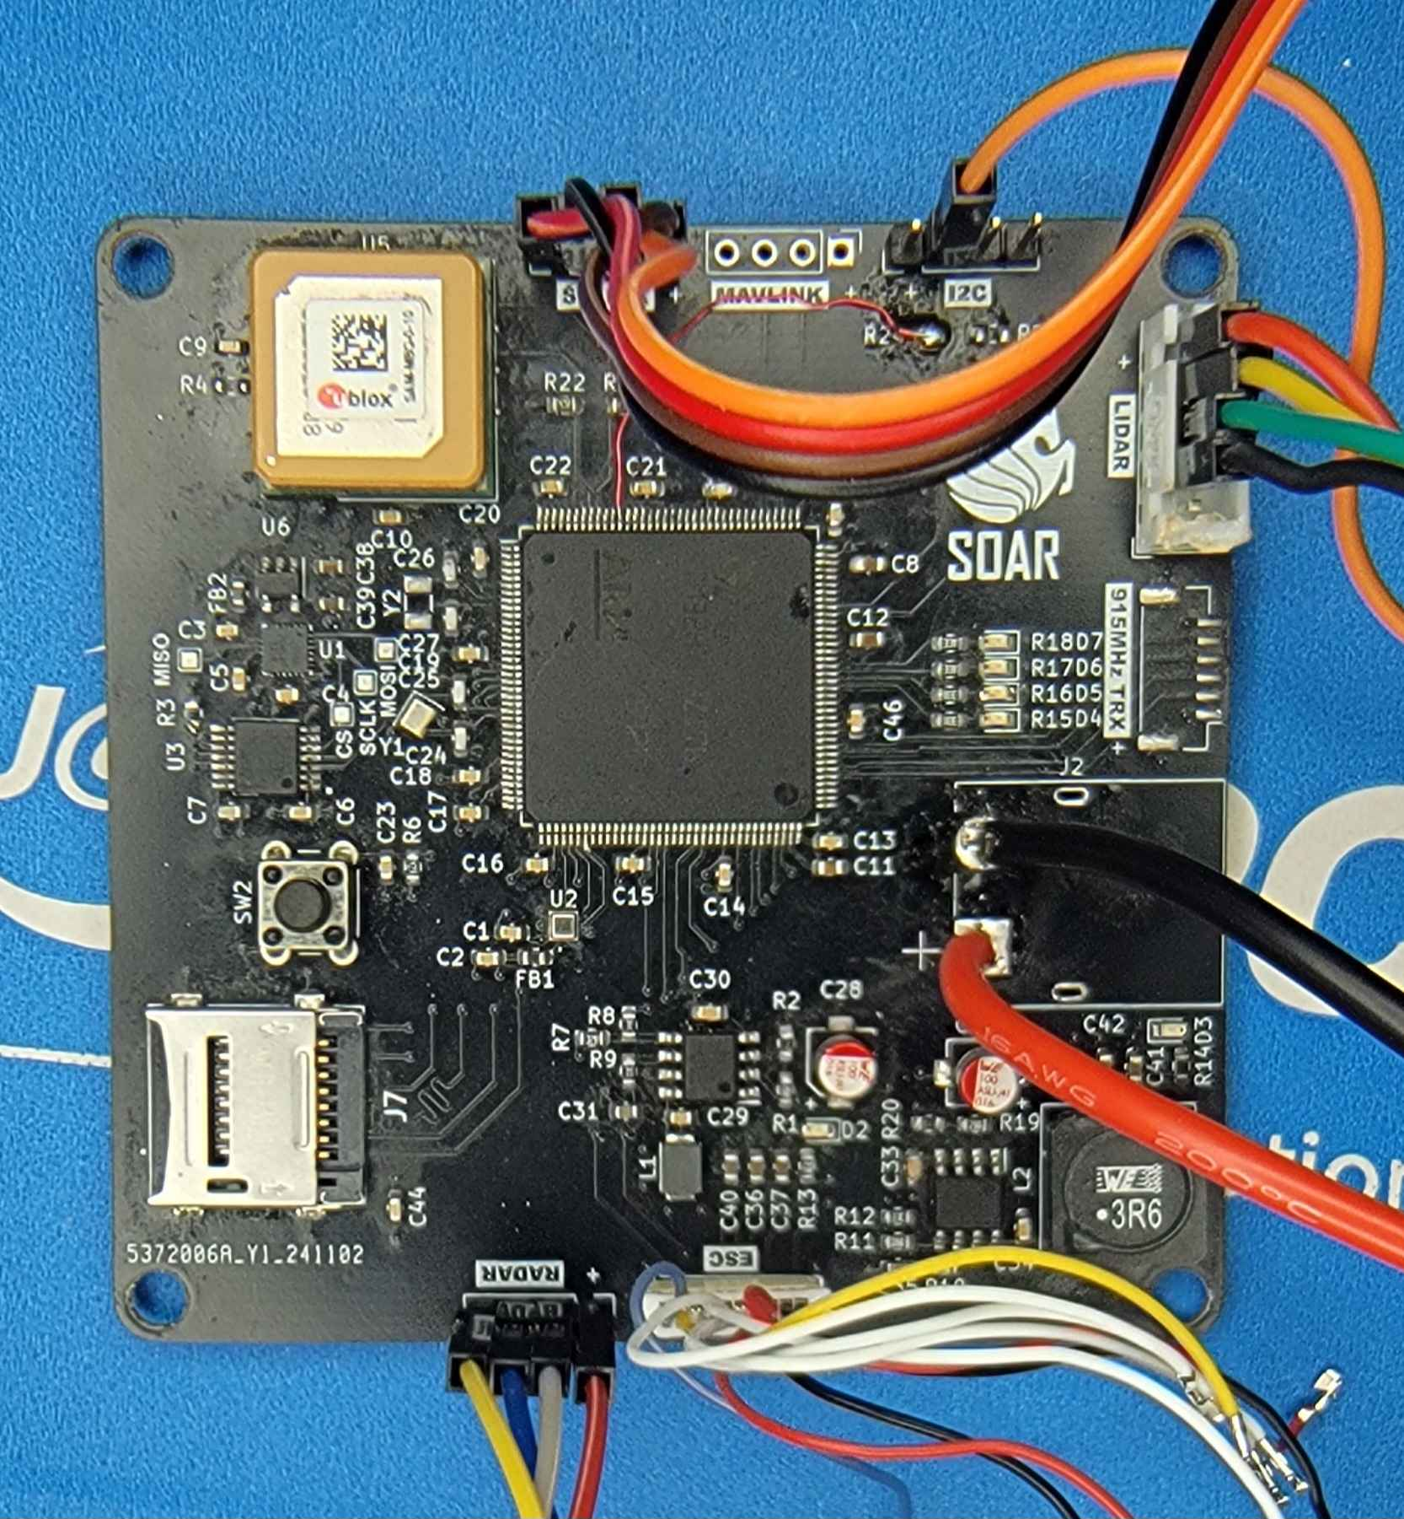
PCB Testing
Power regulation is functional and is able to power all connected devices and IC’s.
Basic functionality testing is complete for all on-board and external sensors.
Drivers are written for all on-board sensors.

Slide 71
Administrative Documentation
The Following Slides Discuss
Bill of Materials
Distribution of Work
Future Schedule

Slide 72
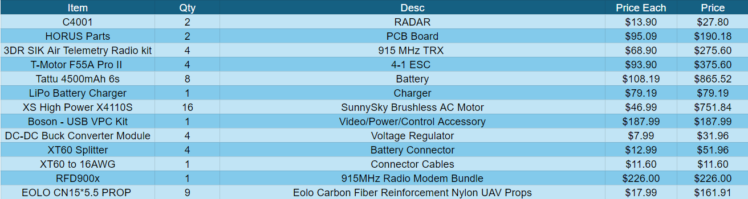

Bill of Materials

Slide 73
ECE Team Distribution of Work
Name / Major | Primary Responsibilities | Secondary Responsibilities
Kate Archibald Electrical Engineering | PSU Design and Implementation | PCB Design
 | Motors and Motor Controls | Autonomous Software Implementation (Hardware)
 | Administrative Documentation | Component Installation
Ethan Fluhr Computer Engineering | Project Lead | Autonomous Software Implementation (Hardware)
 | PCB Design | Antenna and Communications Setup
 | MCU Selection and Implementation | GPS Setup
Abdul Memon Computer Engineering | Autonomous Software Implementation (Software) | PSU Design and Implementation
 | Peripheral Software Implementation | Camera and Sensor Setup
 | Website Design and Management | Component Installation

Slide 74
MAE Team Distribution of Work
Name / Major | Primary Responsibilities | Secondary Responsibilities
Badr Binafif Aerospace Engineering | Aerospace Systems Verification | Parts Research
 | Structural Design | Safety Mechanisms
 | Flight Dynamics Analysis | Budget Analysis
Nawaf Aljudaybi Aerospace Engineering | CAD Airframe | Safety Mechanisms
 | Material Selection | Prototype Fabrication
 | Flight Dynamics Analysis | Budget Analysis
Collin Sumner Mechanical Engineering | Propulsion System Design | Testing
 | Compliance with Standards | Prototype Fabrication
 | CAD Airframe | Safety Mechanisms

Slide 75
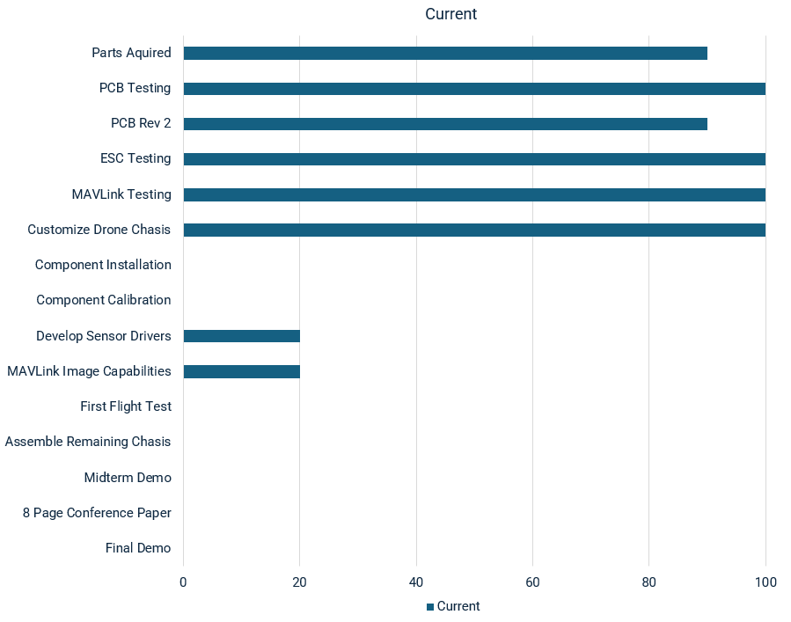
Future Schedule
With recent completion of chassis customization, component installation and calibration is next
Rev 2 will be ordered once first flight test is complete to avoid Rev 3

